Slide 1
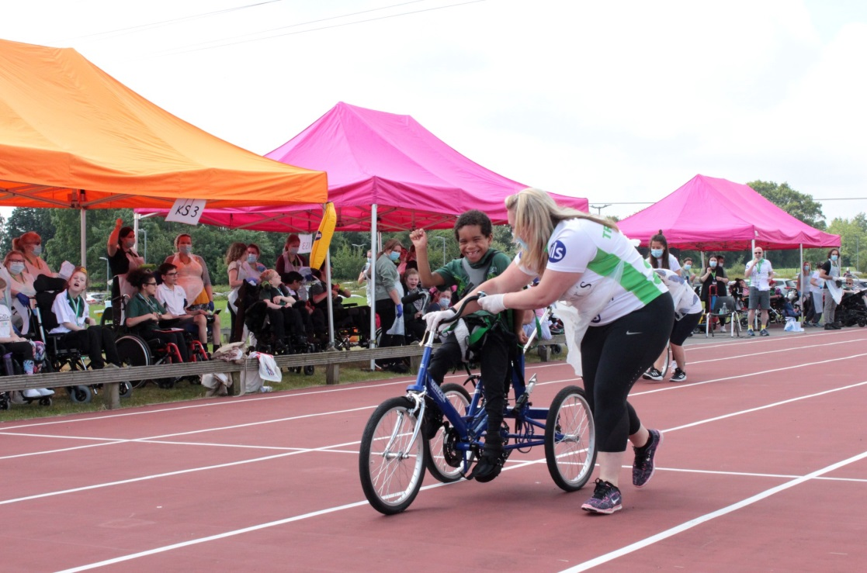
Registered Charity Number: 1092857
The Treloar Trust
Trustee recruitment pack
Director of Fundraising and Marketing
Application Pack
September 2022

Slide 2
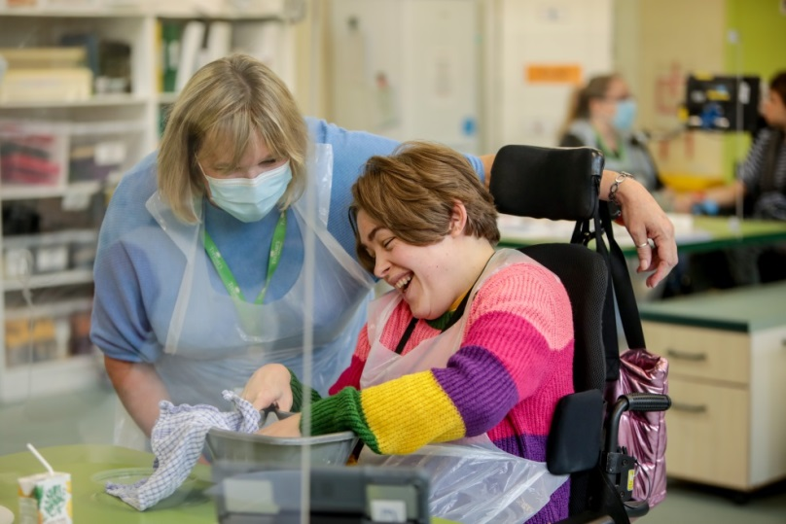
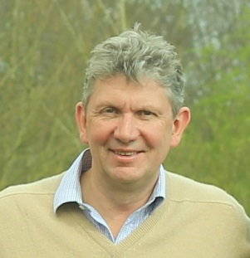
Dear applicant
Dear Friend
Our request for Trustees is a ‘big ask’. An organisation of this calibre and importance deserves the best in governance and leadership, it also requires people who share and demonstrate our values and ethos, detailed further in this pack.
What you will get back in return is extraordinary. I can honestly say that we have the greatest impact on the lives of disabled young people, launching them into successful and rewarding futures. Our outcomes measures show this, and our Ofsted and CQC ratings verify the quality we have to ensure it. I can also guarantee that you will work with some amazing people, both on our board and within our staff.
The Board requires a wide variety of skills and experience, including lived experience and we would be interested to talk with you or receive an application if you feel you have something to offer. At this time we have particular gaps for people with professional backgrounds in finance and accountancy, and people with professional fundraising skills.
We are also continually looking to strengthen our diversity, including appointing more people from black and minority ethnic communities and disabled people into leadership roles.
With best wishes
Alistair Mackintosh
Chair of Trustees
Chair’s Letter

Slide 3
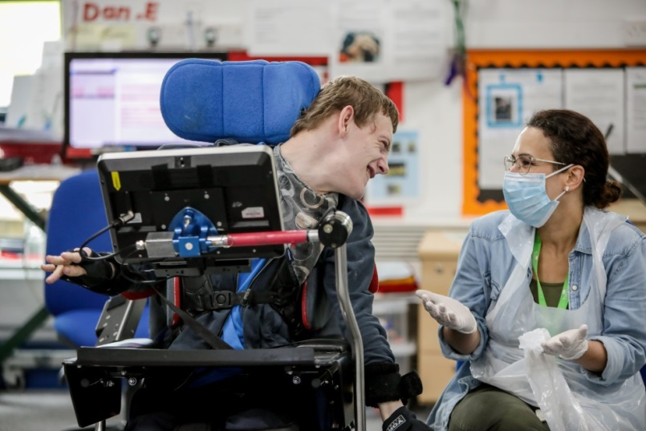
About Treloar’s
Treloar Trust offers outstanding teaching, learning, professional care, therapy, advice and guidance so that every individual can achieve and work towards a future that is as independent as possible.
The main activity of the Trust is the running of a special school and college, however we are also expanding into future living provision for disabled young people who have completed college education, and looking to form a range of partnership and projects to build on our expertise to have impact on a much wider scale.
Treloar School and Treloar College are run by Treloar Trust. We offer around 170 students, aged 2 to 25 years, a specialist environment where learning takes place alongside therapy and care.
Our students are physically-disabled with complex needs. Mainstream schools and colleges cannot provide the support they need to achieve their goals.
Detailed information on the organisation, its services and people can be found at:
www.treloar.org.uk
About the organisation

Slide 4
Our Vision
Our Mission
A world where physically disabled young people take control of their lives and achieve their aspirations.
To enable physically disabled young people to achieve their aspirations by:
Providing personalised learning, therapy and care
Supporting transition into adulthood
Promoting independence and inclusion
Our Values
We are Inclusive
Everyone - regardless of physical ability, where they live or their means - should have the opportunity to take part in life. We treat our beneficiaries with the same dignity as their non-disabled peers and work to remove barriers in their way.
Our students and beneficiaries are always at the centre of everything we do. Before we make decisions, we ask, “How will our students and beneficiaries benefit from this?”
We act with Integrity and Respect
Physically disabled young people should be free to direct their own lives. We listen to young people’s views and support them to make age-appropriate choices about their daily life and informed choices about their future.
We celebrate and promote diversity, value and support each other, and treat everyone with mutual respect. We support a culture of openness, honesty and transparency, where the safeguarding of our students and wellbeing of our staff is paramount.
We strive for Excellence
Physically disabled young people and their families deserve outstanding care and support. We work to make sure all our services are excellent and actively challenge each other to ensure continuous quality improvement.
We continually innovate to ensure that our beneficiaries receive the cutting-edge, excellent support they deserve.

Slide 5
Our
future direction
We undertook a major strategic planning exercise prior to the pandemic, which was put on hold so we could focus on keeping our students and staff safe, and to protect the ongoing education of young people through the most difficult of times.
Now that we are emerging from this period we are again looking to our future and finalising our strategy for the next five years. Our new Strategic Objectives are:
Further our excellence as a school and college for physically disabled young people
Meet student needs by continually developing our education and life skills programmes
Support students to successfully move on from school and college
Develop our non-term time offer alongside our term-time provision
Widen access for students from underrepresented backgrounds and communities
Maintain our specialism in supporting children and young people with higher levels of need in education
Continue to foster our excellence in healthcare, residential care and therapy
Pioneer the practical application of assistive technology to further develop the independence and potential of disabled people
Develop and demonstrate innovation
Contribute on a wider scale to the education and support of physically disabled young people
Work in partnership with local authorities and other education, health and social care providers to support SEND and care objectives across the system
Amplify the voice of disabled children, young people, parents, carers and families to support change in society
Develop future living options for disabled people who have left full-time education
Work with collaborations and partnerships that provide housing, employment and other opportunities
Strategy

Slide 6
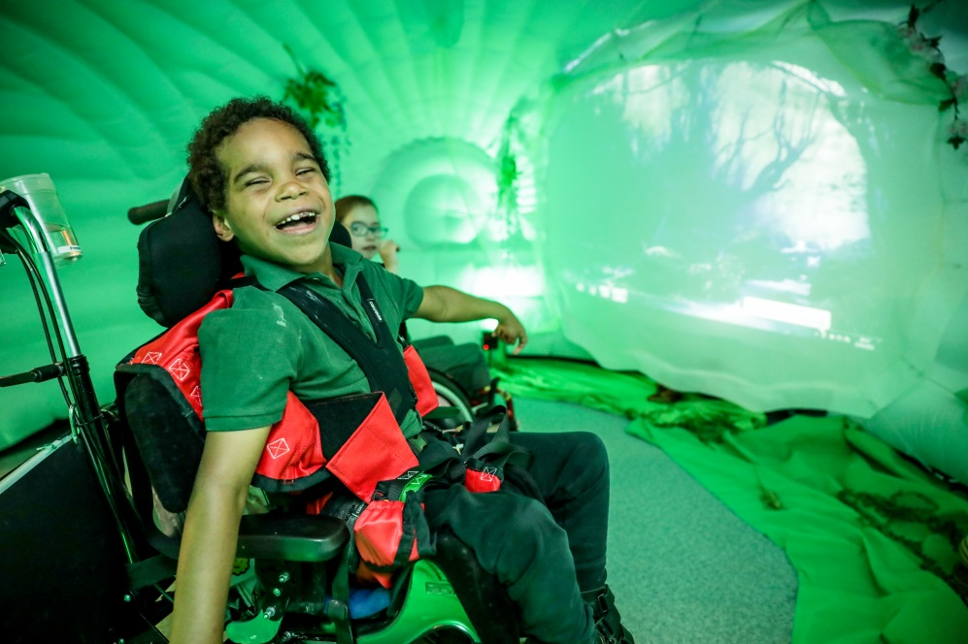
The school and college: our approach
We adopt a person centered approach that enables our students to follow a curriculum that will meet their individual needs and to learn in an accessible, inclusive and safe environment.
Through teams of teachers, therapists, technicians, healthcare workers and a wide range of highly trained support staff, we are uniquely able to meet the physical and emotional needs of students. We exist so students who need additional support can make excellent progress towards their educational and independence aims.
No matter the young person’s aim, our Progress and Transition team are experts in getting them there. The team put the goal’s of the young person at the front and centre of all we do. This goal could be, for example, getting involved with a local peer group, or pursuing a working placement.
We are committed to ensuring our students experience a wide range of activities outside Treloar’s, immersing them in different environments and cultures. A key element of achieving this is our community skills work.
We provide a range of day, residential and respite placements to suit the individual needs of our school and college students and their families.
We also provide residential care and independence training for disabled students who attend a mainstream further education college locally, and transitional housing for young adults. Key to all our services is independent living support preparing young people for their lives after Treloar’s.
We are determined to break down barriers for young disabled people.
Our work

Slide 7
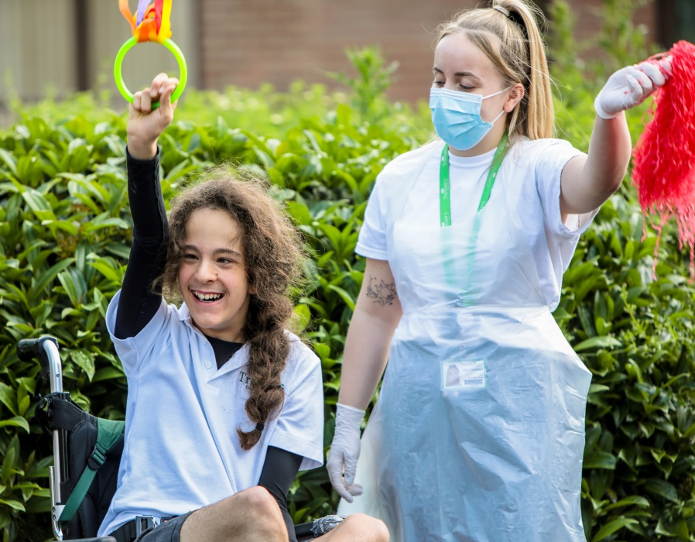
Our
Finances and fundraising
Our annual report and accounts are available here.
Most of our income comes from fees from Local Authorities and CCGs (ICSs) for student education and care.
We are financially strong, with reserves of over three months’ operating expenditure, which is at the top of our policy level. We are of course experiencing much higher costs at this time, for staff and consumables, and have a financial strategy to manage this situation within our available resources.
Fundraising
Pre-COVID we raised about £2m per year from our fundraising, retail and lottery and aim for a 1:3 ratio on voluntary income (excluding trading and lottery). We are still recovering from the impact of the pandemic and the reduction of event income, and are on target to raise £1.6m in the current year.
Our voluntary income comes from events, individual giving including major donor philanthropy, trusts and foundations, corporate and community fundraising. We have a special and close relationship with the Lord Mayor and City of London and receive generous support from many livery companies.
Our fundraising has enabled the majority of significant capital projects at our site and a huge amount of specialist equipment, most recently funding a new outdoor learning centre and classroom. Our supporters are currently working towards a major renovation of our swimming pool.
Finance and fundraising

Slide 8
Our Governance
Treloar Trust is a Registered Charity and Company Limited by Guarantee. It is governed by the Trust Board (Board of Trustees).
The Trust Board sets the strategy and direction of the Trust and is accountable for compliance with legislation and regulatory frameworks, and ensuring that it is financially sustainable.
There are a range of sub-committees:
Finance and Investment Committee
Risk and Compliance Committee
Fundraising and Marketing Committee
Nominations and Remuneration Committee
Strategy Committee
Each Trustee is expected to be a member of at least one of these.
The Trust operates a residential school and college, which are registered and inspected by both Ofsted and the Care Quality Commission for the relevant regulated activities. Governance of the School and College is delegated by the Trust Board to a Governing Body.
The Executive Leadership Team consists of the Chief Executive Officer, the Principal, and the Director of Finance and Resources, supported by a wider leadership team of directors and heads.
Length of term and time commitment
Trustee terms are for three years, and can be extended to a maximum of three terms.
The basic time commitment is three Board meetings per year during the day, plus three sub-committee meetings per year.
Trustees are required to undertake some training, including Safeguarding, and to engage with the organisation as they are able including attending events and meeting staff and students.
Governance and management

Slide 9
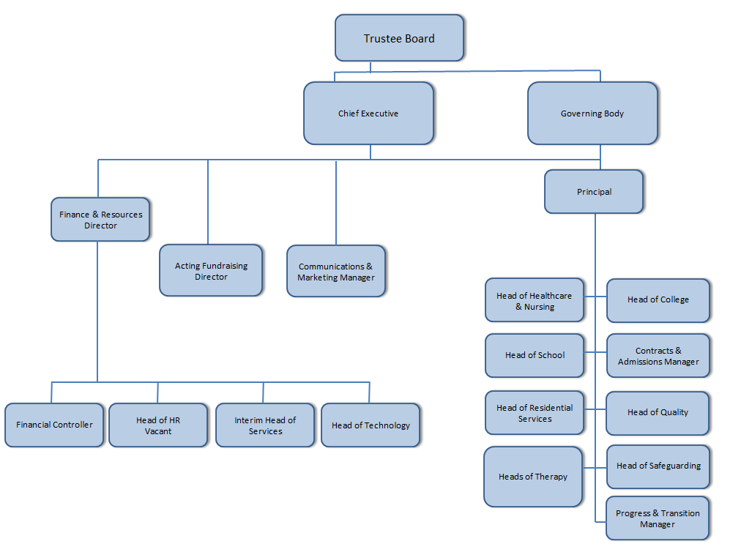
Structure chart
Organisational structure

Slide 10
Responsibilities of Trustees
Establishing the Trust’s core values, mission and objectives.
Determining and reviewing strategic and corporate policies.
Ensuring that the Trust’s policies meet, and continue to meet, the requirements of the law, best practice and other regulatory bodies.
Reviewing and monitoring of financial management / Business Plan / capital and revenue budgets.
Determining and periodically reviewing the Trust’s structure of committees and approving their terms of reference.
Line management of the Chief Executive including appointment, performance review, terms and conditions, dismissal etc., subject to any restrictions imposed by the Trust’s Human Resources policies.
Being represented in the appointment of Directors reporting to the Chief Executive and approving the executive management staffing structure and staffing establishment.
Performance monitoring, focusing on the effectiveness of the Trust in meeting its objectives.
Effectiveness and consistency of Standing Orders, financial regulations and delegation.
Standards of conduct and probity for Committee members.
The Trust’s Equal Opportunities Policy, Health & Safety at Work Policies and other policies required to ensure that the Trust meets its statutory responsibilities and can demonstrate good practice.
Review and agreement of the annual financial report.
Approving decisions affecting the assets of the Charity.
Oversight of Governing Body to ensure that it meets its responsibilities with respect to School and College.
The role

Slide 11
How to apply
To apply, please submit a CV and covering letter addressing what you would bring to the role, to be returned to Penelope.Butler@treloar.org.uk
The closing date for this pack is 31 October 2022. However this is not a competitive process so applications will be welcomed and considered promptly at any time.
If you would like to have an informal conversation with our CEO, Ryan Campbell, please contact Penny at the address above.
Treloar Trust is committed to safeguarding children, young people and vulnerable adults.
All successful candidates will be subject to a panel interview, and an enhanced DBS check along with other relevant recruitment/appointment checks.
As a Company Director and Charity Trustee applicants must be eligible for these roles and not subject to disqualification. Further details on this and the statutory responsibilities of the role are available at the relevant Charity Commission and Government websites
The essential trustee: what you need to know, what you need to do - GOV.UK (www.gov.uk)
Being a company director - GOV.UK (www.gov.uk)
How to apply

